Slide 1


Content Category Analysis
Social Buzz

Slide 2


Today's agenda
Project recap
Problem
The Analytics team
Process
Insights
Summary

Slide 3

Social Buzz is a fast growing technology unicorn that need to adapt quickly to it’s global scale.
Accenture has begun a 3 month POC focusing on three tasks:
An audit of Social Buzz’s big data practice
Recommendations for a successful Ipo
Analysis to find Social Buzz’s top 5 most popular categories of content
Project Recap

Slide 4

Problem
Over 100000 posts per day
36,500,000 pieces of content per year!
But how to capitalize on it when there is so much?
Analysis to find Social Bizz’s top 5 most popular categories of content

Slide 5



Andrew Fleming
Chief Technical Architect
The Analytics team
Marcus Rompton
Senior Principle
{Phani Priya
Data Analyst

Slide 6
Process
1
Data Understanding
2
Data Cleaning
3
Data Modelling
4
Data Analysis
5
Uncover Insights

Slide 7

Insights
Number of Unique Categories
Reactions to the Most Popular Category
Month with the Most Posts
16
1897
2021 - 05

Slide 8
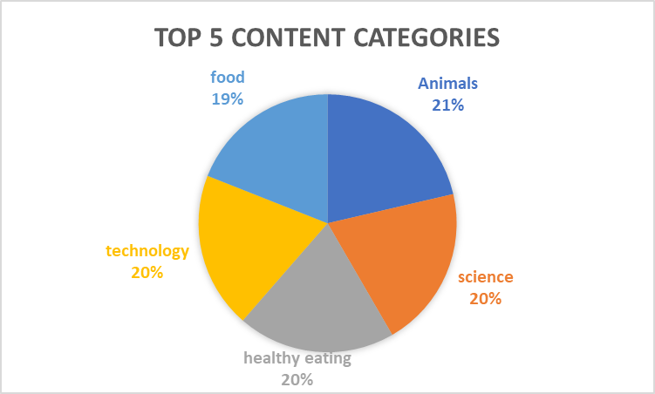

Slide 10
Summary
Animals and Science are the two most popular categories of content, showing that people enjoy “real-life” and “factual” content the most.
Food is a common theme with the top 5 categories with “Healthy Eating” ranking the highest. This may give an indication to the audience with your user base. You could use this insight to create a campaign and work with healthy eating brands to boost user engagement .

Slide 11
Thank you!
ANY QUESTIONS?

